Slide 1
COA minor project
Presented by:-
A .Thvisha
171FA04440

Slide 2
Programs :
Program that accepts characters in lower case, stores them in an array and prints them in the upper-case and vice - versa
Write a query to change the lower case of strings using upper function
Program that will read a positive decimal number and print its factorial in decimal form using MUL and DIV instructions

Slide 3
Software requirements
Basic software requirement to develop programs :-
Language – assembly.
Operating system – windows 7 (or) higher .
Editor – dosbox.
Assembler – tasm

Slide 4
Hardware requirements
Basic hardware requirements to develop programs
A laptop or computer
Processor – Intel core i3 or more.
Hard disk – 5GB .
Base memory – 4GB .

Slide 5
Assembly language
A programming language that uses symbolic names to represent operations, registers and memory locations.
Slightly high level language.
Better than machine language.
Assembler translate assembly to machine code.
Compiler translate high-level programs to machine code
Either directly, or
Indirectly via an assembler

Slide 6
SYNTAX FOR ASSEMBLY LANGUAGE
[label] mnemonic [operands] [;comment]
The fields in the square brackets are optional.
A basic instruction has two parts.
The first one is the name of the instruction or mnemonic which is to be executed.
Second one is the operands or the parameters of the command.

Slide 7
ADVANTAGES AND DISADVANTAGES
ADVANTAGES:
shows how program interfaces with the processer, operating system, and BIOS.
Shows how data is represented and stored in memory and on external devices.
Clarifies how processer accesses and executes instructions and how instructions access and process data.
Clarifies how a program accesses external devices.
DISADVANTAGES:
Since there is more chance for errors debugging is difficult.
It is difficult to understand by the user compare to high level language.

Slide 8
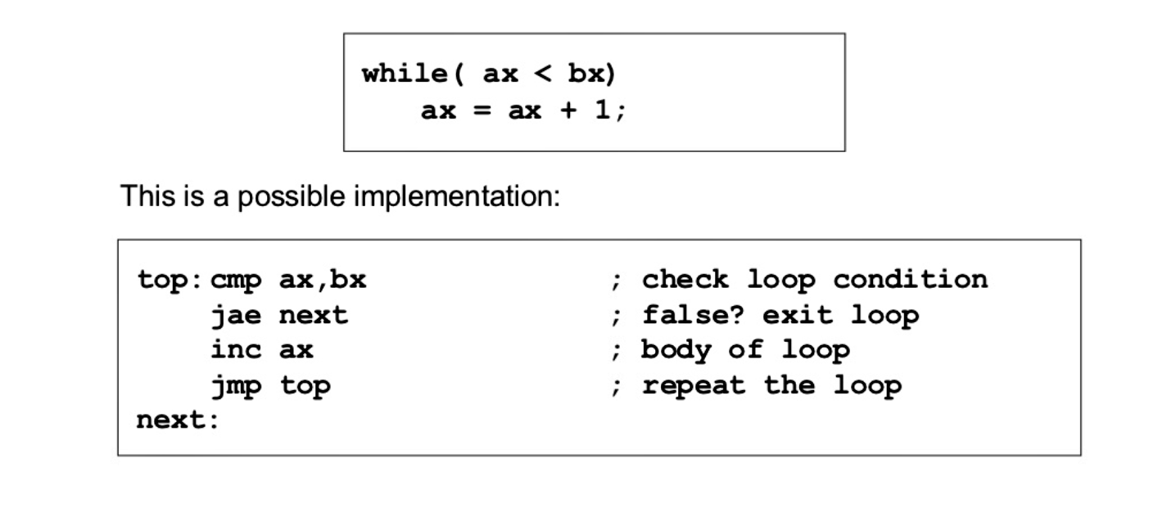
Program that accepts characters in lower case, stores them in an array and prints them in the upper-case and vice - versa
This program is used to convert lower case letters of a string into upper case letters and vice-versa.
In this program the string is taken as a character array and each letter in string is converted lower case or upper case
The loop that will be used in this program while loop
The while loop is a if statement fallowed by the body of loop fallowed by unconditional jump to top of the loop.
While loop is used to check the condition first if the condition is true then loop will be executed else loop will not be
Example for while loop :-

Slide 9
explanation
cmp :- cmp instruction is used to compare destination operand to source operand.
Note :-non-destructive subtraction of source from destination (destination operand is not changed)
Syntax:- cmp destination,source
jae :- jae is a jump based unsigned comparison , jae is nothing but jump if above or equal
Jae is used when the condition is used to check variable is >= some other variable.
Ex : if a>= b
Jmp :- jmp is used to perform unconditional unconditional jump.
Such an instruction transfers the flow of execution by changing the instruction pointer register.
Syntax:- jmp position
Inc :- it is a key word for incrementing the value.
Syntax:-inc operand

Slide 10
Write a query to change the lower case of strings using upper function
This program is used to convert lower case letters of a string into upper case letters .
In this program upper function is used to convert lower case letters into upper case letters
The upper function is a type of string function which is used to convert lower case letters into upper case letters
But it do not change the uppercase letters which are in the string
Here we don’t use arrays to store the string

Slide 11
explanation
The main key words (or) instructions used are
Upper function :- it converts lower case letters into upper case letters
Mov:- it is used to move data from source to destination
Cmp:- it is used to two operands equal or not

Slide 12
Program that will read a positive decimal number and print its factorial in decimal form using MUL and DIV instructions
This program is used to print factorial of a decimal numbers using mul and div instructions
in this programs negative numbers are not allowed
The loops that used are while loop and main instructions used in this program is mov , mul ,div
Inc instruction also used mainly in this program for incrementing the value of operand

Slide 13
explanation
Mul :- it is used to multiply the values of two operands
Syntax:-mul operand
Div :- it is used to divide the values of two operands
Syntax:-div operand
LEA :- The LEA instruction is used to load a pointer into a register.
REP:- IT IS USED TO REPEATE some step again
Syntax:- rep step to be repeated

Slide 14
Thank you

